Slide 1
Classification

Slide 2
What We’ll Cover
What is classification?
How does logistic regression look like?
How does logistic regression learn?
Binary, multi-label, multi-class classification

Slide 3


What is classification?

Slide 4
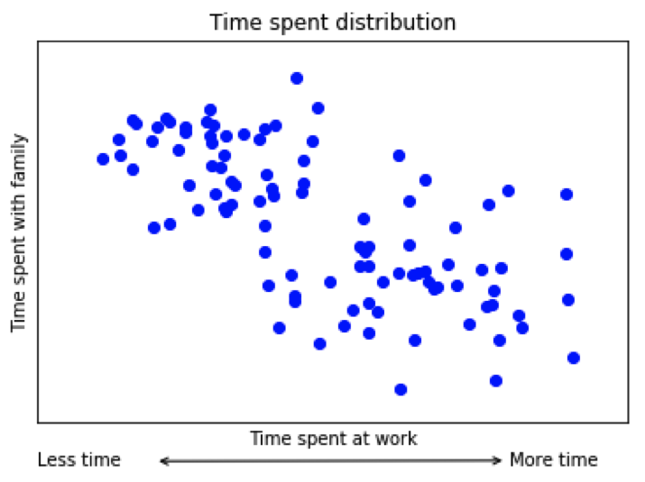
What is classification?
What are they?
Predict categories in data
Looking for groups in data
Notes:
Photo: https://www.flickr.com/photos/107442568@N08/12547327134

Slide 5
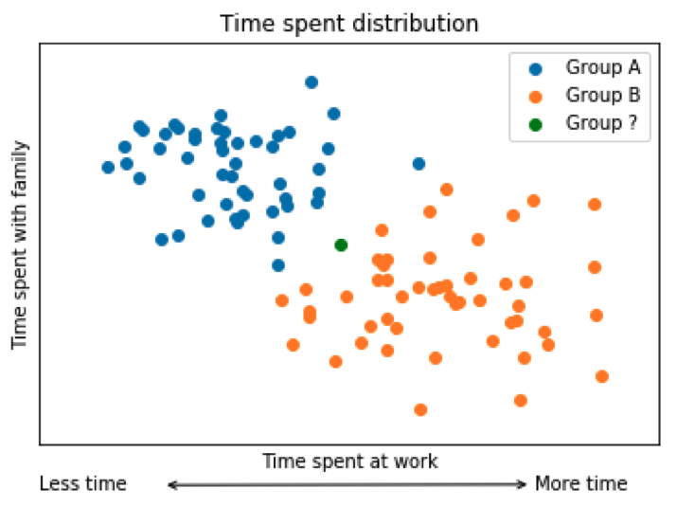
What is classification?
What are they?
Predict categories in data
Looking for groups in data
Notes:
Photo: https://www.flickr.com/photos/107442568@N08/12547327134

Slide 6
What is classification?
What are they?
Predict categories in data
Looking for groups in data
When do you use them?
When you’re interested in an attribute
When you don’t need an exact numerical values

Slide 7
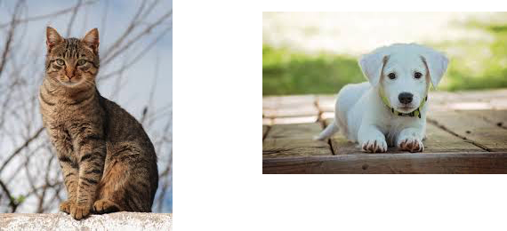
What is classification?
What are they?
Predict categories in data
Looking for groups in data
When do you use them?
When you’re interested in an attribute
When you don’t need an exact numerical values
Notes:
Photo: https://www.flickr.com/photos/107442568@N08/12547327134

Slide 8
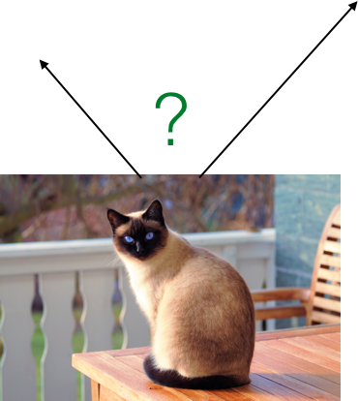
What is classification?
What are they?
Predict categories in data
Looking for groups in data
When do you use them?
When you’re interested in an attribute
When you don’t need an exact numerical values
Notes:
Photo: https://www.flickr.com/photos/107442568@N08/12547327134

Slide 9
Logistic Regression

Slide 10
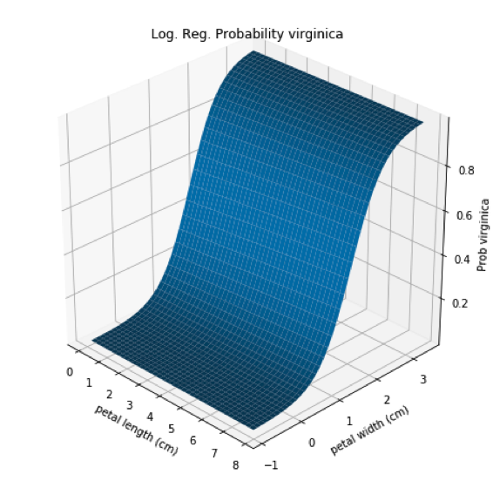
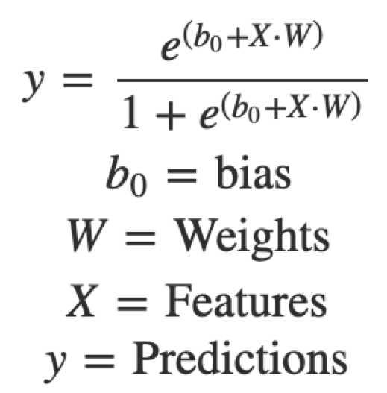

How does Logistic Regression look like?
Estimate parameters of logistic function
Notes:
Photo: https://p0.piqsels.com/preview/75/886/497/4480j35547m45663a3pm5fmsvd.jpg

Slide 11
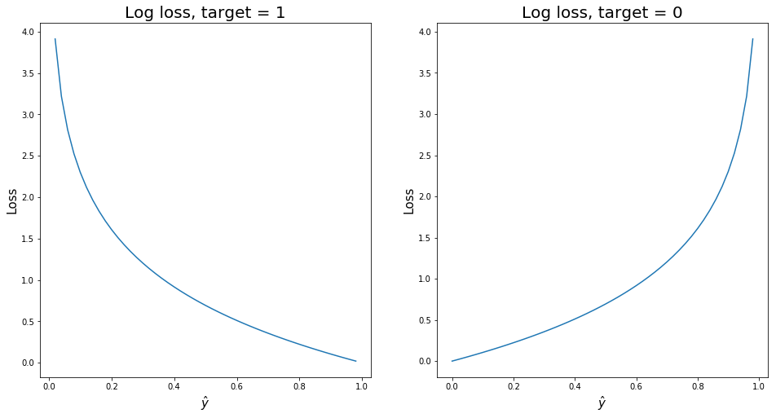


How does Logistic Regression learn?
Loss function
Log-loss
y - target
- prediction
Notes:
Photo: https://p0.piqsels.com/preview/75/886/497/4480j35547m45663a3pm5fmsvd.jpg

Slide 12
How does Logistic Regression learn?
Loss function
Log-loss
y - target
- prediction
Severity of error for each observation
Notes:
Photo: https://p0.piqsels.com/preview/75/886/497/4480j35547m45663a3pm5fmsvd.jpg

Slide 13
How does Logistic Regression learn?
Loss function
Log-loss
y - target
- prediction
i = observation i
Notes:
Photo: https://p0.piqsels.com/preview/75/886/497/4480j35547m45663a3pm5fmsvd.jpg

Slide 14
How does Logistic Regression learn?
Loss function
Log-loss
y - target
- prediction
i = observation i
Notes:
Photo: https://p0.piqsels.com/preview/75/886/497/4480j35547m45663a3pm5fmsvd.jpg

Slide 15
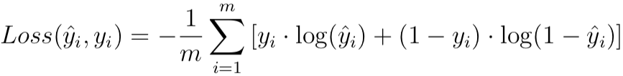
How does Logistic Regression learn?
Loss function
Log-loss
y - target
- prediction
i = observation i
m - number of observations
Notes:
Photo: https://p0.piqsels.com/preview/75/886/497/4480j35547m45663a3pm5fmsvd.jpg

Slide 16
How does Logistic Regression learn?
Cost function
Generalized loss function
Notes:
Photo: https://p0.piqsels.com/preview/75/886/497/4480j35547m45663a3pm5fmsvd.jpg

Slide 17

How does Logistic Regression learn?
Cost function
Generalized loss function
Notes:
Photo: https://p0.piqsels.com/preview/75/886/497/4480j35547m45663a3pm5fmsvd.jpg

Slide 18
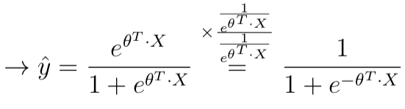
How does Logistic Regression learn?
Cost function
Generalized loss function
Notes:
Photo: https://p0.piqsels.com/preview/75/886/497/4480j35547m45663a3pm5fmsvd.jpg

Slide 19
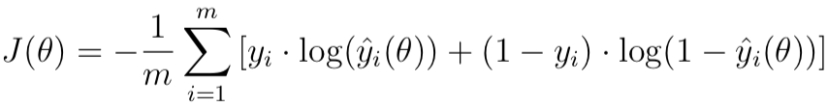
How does Logistic Regression learn?
Cost function
Generalized loss function
Notes:
Photo: https://p0.piqsels.com/preview/75/886/497/4480j35547m45663a3pm5fmsvd.jpg

Slide 20
How does Logistic Regression learn?
Cost function
Generalized loss function
Notes:
Photo: https://p0.piqsels.com/preview/75/886/497/4480j35547m45663a3pm5fmsvd.jpg

Slide 21

How does Logistic Regression learn?
Cost function
Generalized loss function
Notes:
Photo: https://p0.piqsels.com/preview/75/886/497/4480j35547m45663a3pm5fmsvd.jpg

Slide 22
How does Logistic Regression learn?
Cost function
Generalized loss function
In this case, extra is nothing
Notes:
Photo: https://p0.piqsels.com/preview/75/886/497/4480j35547m45663a3pm5fmsvd.jpg

Slide 23
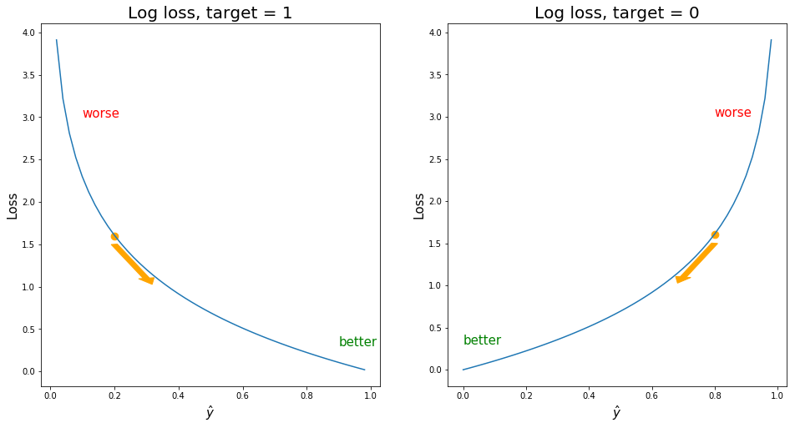
How does Logistic Regression learn?
Minimize loss
Notes:
Photo: https://p0.piqsels.com/preview/75/886/497/4480j35547m45663a3pm5fmsvd.jpg

Slide 24

How does Logistic Regression learn?
Minimize loss
Notes:
Photo: https://p0.piqsels.com/preview/75/886/497/4480j35547m45663a3pm5fmsvd.jpg

Slide 25

How does Logistic Regression learn?
Minimize loss
j - individual components
Notes:
Photo: https://p0.piqsels.com/preview/75/886/497/4480j35547m45663a3pm5fmsvd.jpg

Slide 26
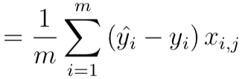
How does Logistic Regression learn?
Minimize loss
j - individual components
Notes:
Photo: https://p0.piqsels.com/preview/75/886/497/4480j35547m45663a3pm5fmsvd.jpg

Slide 27
Gradient Descent Optimizer

Slide 28
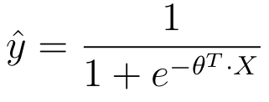
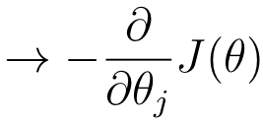
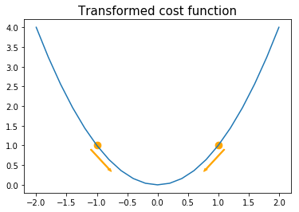
Gradient Descent
Initialize randomly
Notes:
Photo: https://p0.piqsels.com/preview/75/886/497/4480j35547m45663a3pm5fmsvd.jpg

Slide 29
Gradient Descent
Initialize randomly
For each weight move into direction of lower loss
Notes:
Photo: https://p0.piqsels.com/preview/75/886/497/4480j35547m45663a3pm5fmsvd.jpg

Slide 30


Gradient Descent
For each weight move into direction of lower loss
j - individual components
- learning rate
Notes:
Photo: https://p0.piqsels.com/preview/75/886/497/4480j35547m45663a3pm5fmsvd.jpg

Slide 31
Gradient Descent
Batch gradient descent
Use all instances to calculate gradients
Notes:
Photo: https://p0.piqsels.com/preview/75/886/497/4480j35547m45663a3pm5fmsvd.jpg

Slide 32
Gradient Descent
Batch g.d. (slow, converges)
Use all instances to calculate gradients
Notes:
Photo: https://p0.piqsels.com/preview/75/886/497/4480j35547m45663a3pm5fmsvd.jpg

Slide 33
Gradient Descent
Batch g.d. (slow, converges)
Use all instances to calculate gradients
Stochastic g.d.
Use only one observation to calculate gradient
Notes:
Photo: https://p0.piqsels.com/preview/75/886/497/4480j35547m45663a3pm5fmsvd.jpg

Slide 34
Gradient Descent
Batch g.d. (slow, converges)
Use all instances to calculate gradients
Stochastic g.d. (fast, doesn’t conv.)
Use only one observation to calculate gradient
Notes:
Photo: https://p0.piqsels.com/preview/75/886/497/4480j35547m45663a3pm5fmsvd.jpg

Slide 35
Gradient Descent
Batch g.d. (slow, converges)
Use all instances to calculate gradients
Stochastic g.d. (fast, doesn’t conv.)
Use only one observation to calculate gradient
Mini-batch g.d.
Use a subset (batch) of observations to find gradient
Notes:
Photo: https://p0.piqsels.com/preview/75/886/497/4480j35547m45663a3pm5fmsvd.jpg

Slide 36
Gradient Descent
Batch g.d. (slow, converges)
Use all instances to calculate gradients
Stochastic g.d. (fast, doesn’t conv.)
Use only one observation to calculate gradient
Mini-batch g.d. (fast, doesn’t conv.)
Use a subset (batch) of observations to find gradient
Notes:
Photo: https://p0.piqsels.com/preview/75/886/497/4480j35547m45663a3pm5fmsvd.jpg

Slide 37
Binary Multiclass &
Mutlilabel
Classification

Slide 38
Binary Classification
Yes or No
Mainly testing for is or is not

Slide 39
Binary Classification
Yes or No
Mainly testing for is or is not
Cat or not cat?

Slide 40









Binary Classification
Yes or No
Mainly testing for is or is not
Cat or not cat?

Slide 41
Binary Classification
Yes or No
Mainly testing for is or is not
Cat or not cat?
1 or not 1

Slide 42
Multiclass Classification
Assign to specific label
Looking at labels that are mutually exclusive
All classes can be tested simultaneously
Some algorithms have it as a natural option, otherwise use
One versus One, or
One versus Rest

Slide 43
Multiclass Classification
One versus Rest
Binary classifier for each class (e.g. 1 vs not 1, 2 vs not 2…)
Pick the one with the highest score
N classifiers
Less computational expensive
More problems with dataset imbalances

Slide 44
Multiclass Classification
One versus One
Train a classifier for each comparison (e.g. 1v2 1v3 1v4…)
E.g. pick the one that won the most matchups
N(N-1)/2 classifiers
More computationally expensive
Less problems with dataset imbalances

Slide 45
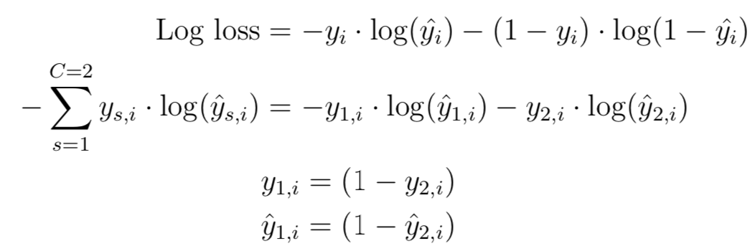
Multiclass Classification
Multinomial loss

Slide 46
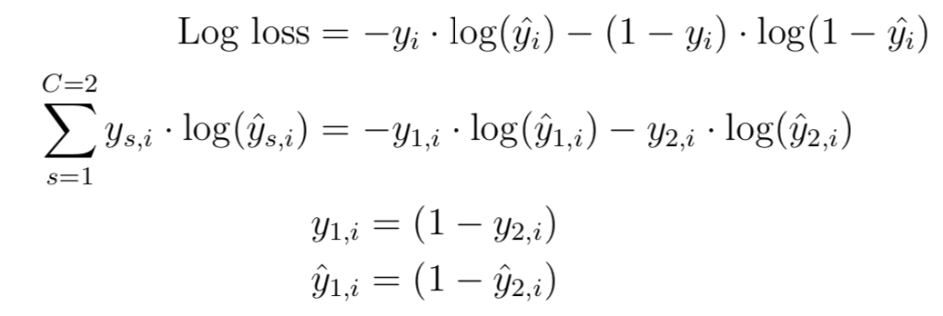
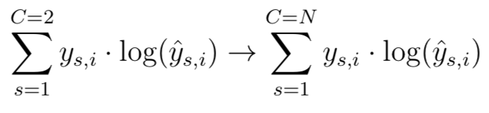
Multiclass Classification
Multinomial loss
Extend log loss function to more than 2 variables

Slide 47
Multilabel Classification
Assign specific properties
Looking at labels that are not mutually exclusive from each other
Each class can be tested independently
Cat
Brown
Tall
Round

